Slide 1


Town of Argyle
Form-Based Codes Overview
Issues and Opportunities
June 2019

Slide 2
Agenda
Comprehensive plan overview (inception of FBC concept)
How Argyle’s FBC was developed (meetings, calibration based on retail market update, coordination with property owners, etc.)
FBC 101 (comparison of FBC versus conventional zoning)
Overview of how Argyle’s FBC works
Goals of the current Argyle FBC
Options for Next Steps

Slide 3
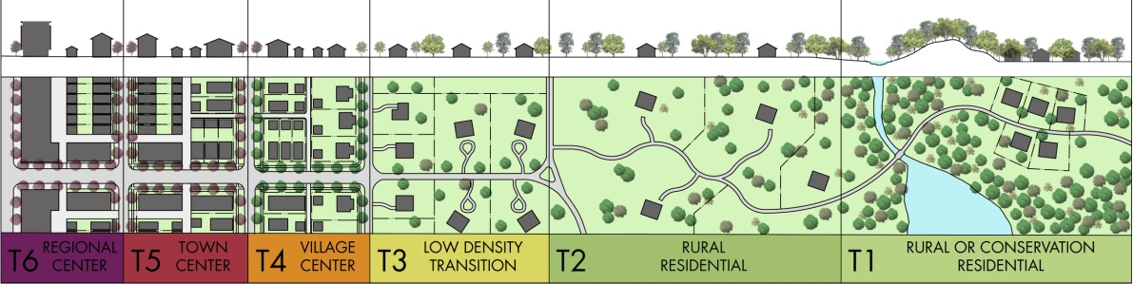
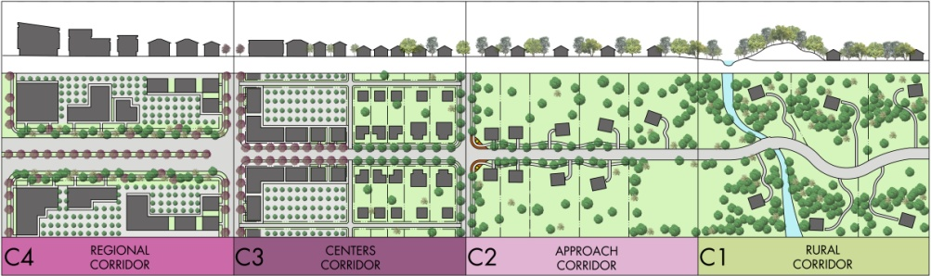
Comprehensive Plan (Adopted in 2009)

Slide 4
2017 Comprehensive Plan Update

Slide 5
Inputs to Argyle’s Form-Based Code
5
Tax Base
Economic Development
Open space
Market Realities
Argyle
Form-Based Code
Infrastructure Needs and Phasing
Leadership
Property Owners
Zoning
Transitions/Scale
Town character

Slide 6
Project Process & Timeline
6
Project Kick-off and Preliminary Assessment – Spring 2013
Market Analysis – Spring 2013
Stakeholder Interviews – Summer 2013
Community Code Workshop – Fall 2013
Develop Form-Based Code – Spring/Summer 2014
Public Adoption Process – Spring 2015

Slide 7
2009 Comp. Plan vs. 2014 Market Analysis
20 YEAR Horizon
20 YEAR
 | Strategic Plan | Market Analysis
Single Family Residential (Units) | 3,684 | 1,800
Urban High Density (Units) | 1,440 | 1,700
Commercial (SF) | 24,023,340 | 1,850,266
ANNUALLY
 | Strategic Plan | Market Analysis
Single Family Residential (Units) | 184 | 90
Urban High Density (Units) | 72 | 85
Commercial (SF) | 1,201,167 | 92,513

Slide 8
Updated Market Analysis (2014)
8
Demand for 248 units of single-family residential annually:
    124 units valued greater than $250K
    60 units valued over $300K
100 units of mixed residential annually beginning in 2018.
Market may support an additional 1.7M SF of retail (including grocery, restaurants, and convenience stores) and substantial campus office
Can Absorb 36,000 SF of small office annually
All this is in the context of creating walkable, mixed use centers/nodes

Slide 9
Current Real Estate Trends (2019):
Maximizing Commercial Development Opportunities
Retail sector is still evolving and shrinking due to e-commerce and oversupply
Restaurants and entertainment combined with placemaking and walkability are driving commercial destinations (especially in Mixed Use developments)
Corporate relocation decisions are increasingly made with walkability and quality of life factors
Employees and residents are looking for more “amenities”

Slide 10
“The traditional attractions of the suburbs—larger homes, good schools, and lots of green space—have not changed. What is different is that amenities now in demand include access to mass transit and walkable neighborhoods in proximity to shopping and entertainment.”

Slide 11
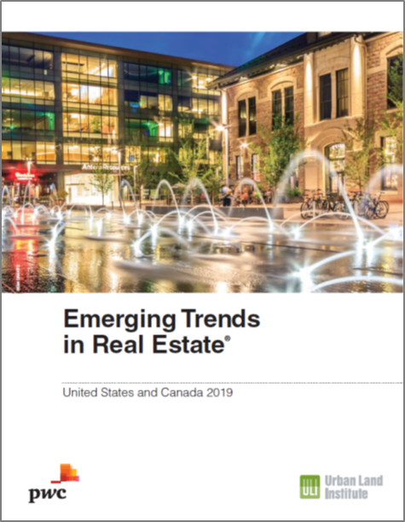

Slide 12
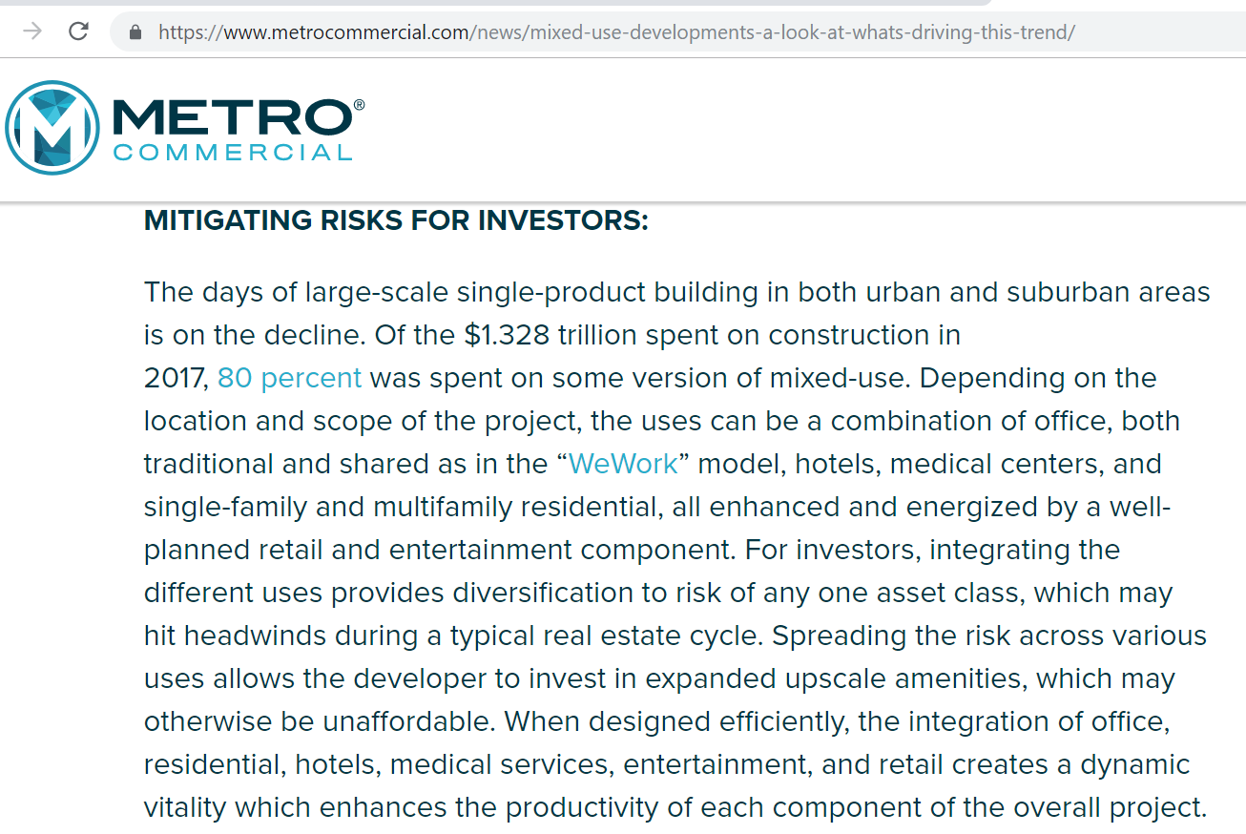

Slide 13
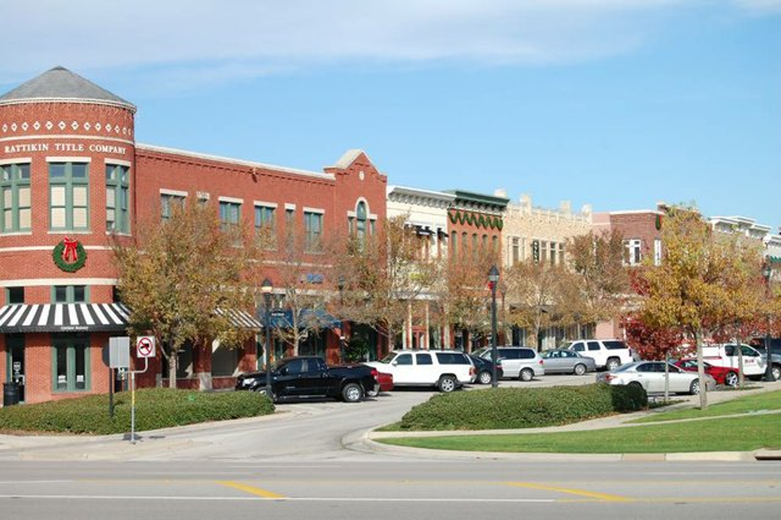
Essential Ingredients of Mixed Use
Active upper floors:
office or residential
Shade along the
sidewalk
Storefronts with
display windows
Contiguous buildings
along the street
Streets tamed with
on-street parking

Slide 14
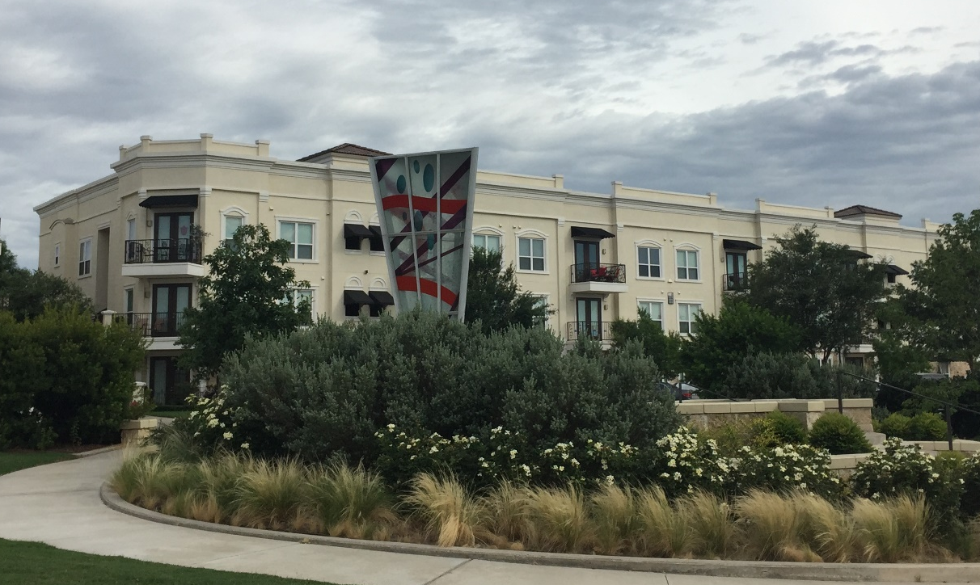
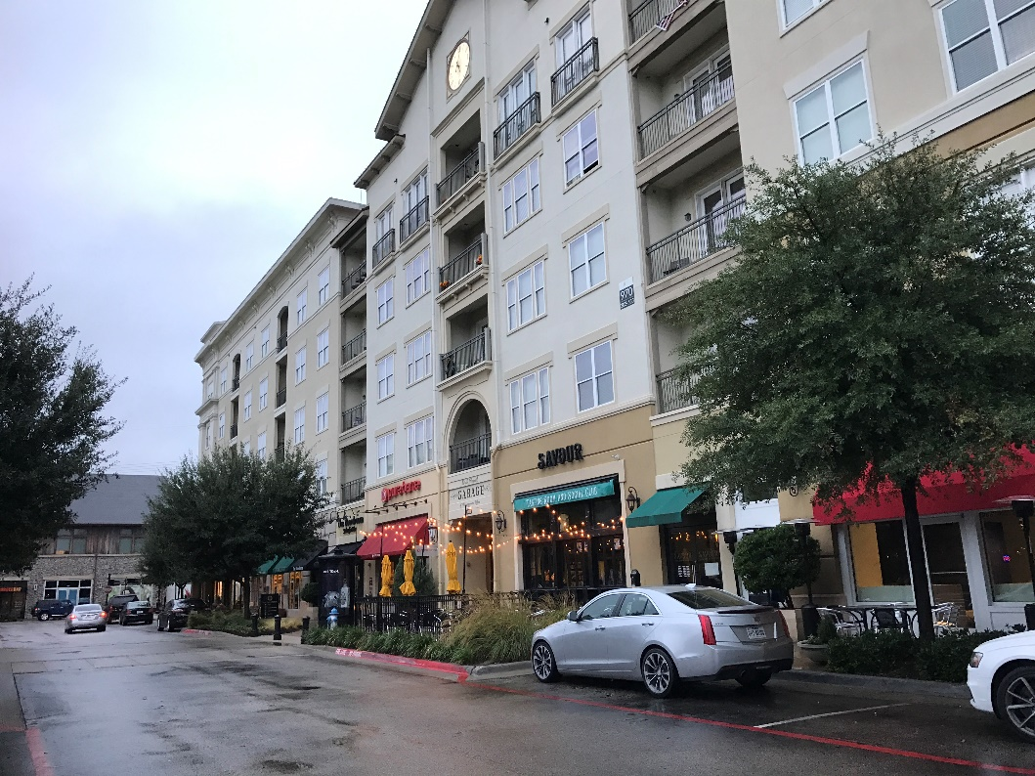
Essential Ingredients of Mixed Use

Slide 17
Importance of a Mix of Residential Uses in Mixed Use Developments
Provides vitality and “sense of place” to the development
Provides options for a segment of choice residents who prefer low maintenance and high quality amenities
Spreads the risk of the development across multiple use (product) types
Makes the development more resilient to weather changing real-estate market conditions
Makes it easier to attract quality restaurant and retail uses
Higher return on public infrastructure in terms of tax revenues (sales and property taxes)

Slide 18
Comparison of FBC Versus Conventional Zoning

Slide 19
How Conventional Zoning Works

Slide 20
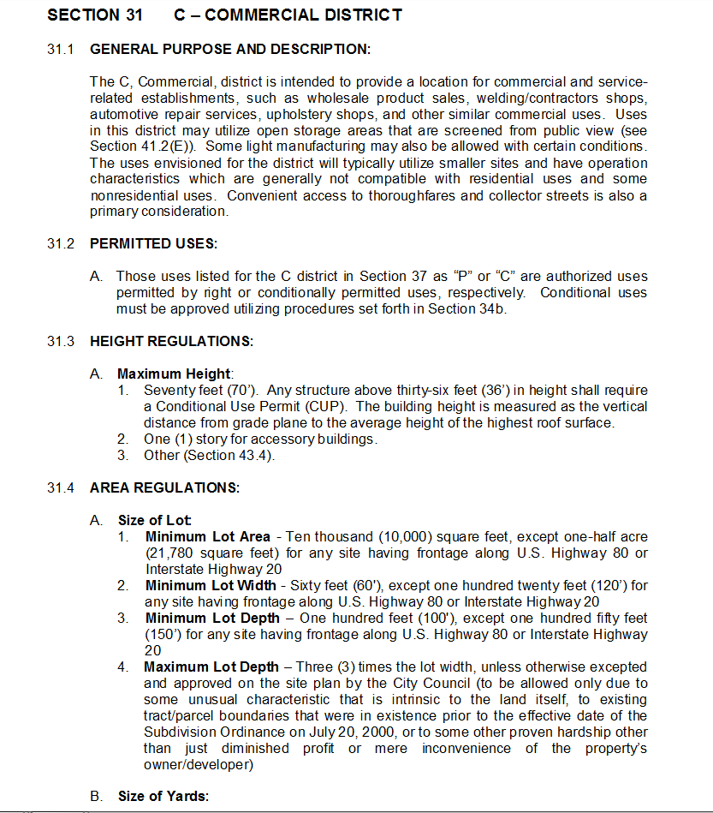
How Conventional Zoning Works
Addresses only what happens on private property
Objective standards
Setbacks
Parking
Height
Use
Lot Coverage/Floor Area Ratio
Façade design (articulation, materials)
Landscaping, signage (Typically same for all commercial districts)
Ultimate result is development is mostly car-dependant

Slide 21
Conventional Zoning
(Focus on Use)
Form
Use
Density

Slide 22
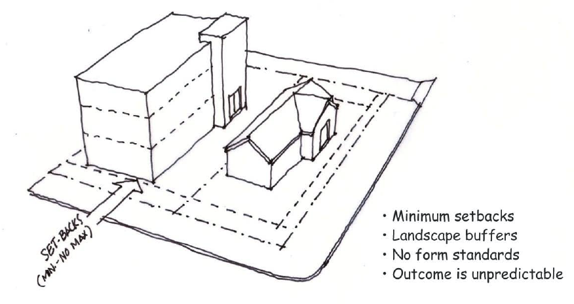
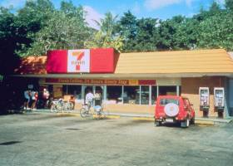
Conventional Zoning
Single use pods of development
Buffers instead of transitions
Minimum setbacks
No form or design standards
Unpredictable outcomes
Mostly auto-oriented
Address private development standards only
Source: M Huston, 2013

Slide 23
What are Form-Based Codes?

Slide 24
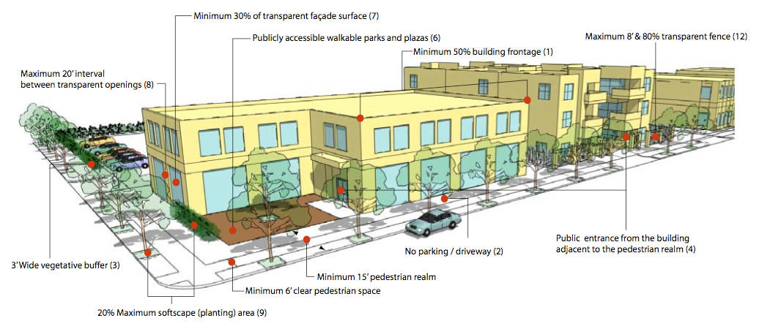
How FBC’s Work
Addresses how each development relates to adjoining sites and the street context (interface between public and private realms)
More than aesthetic standards
All elements of the built environment are tailored to the desired urban “form”
Often deals with subdivision regulations and public infrastructure standards
Ultimate goal is for development to be “pedestrian oriented”

Slide 25
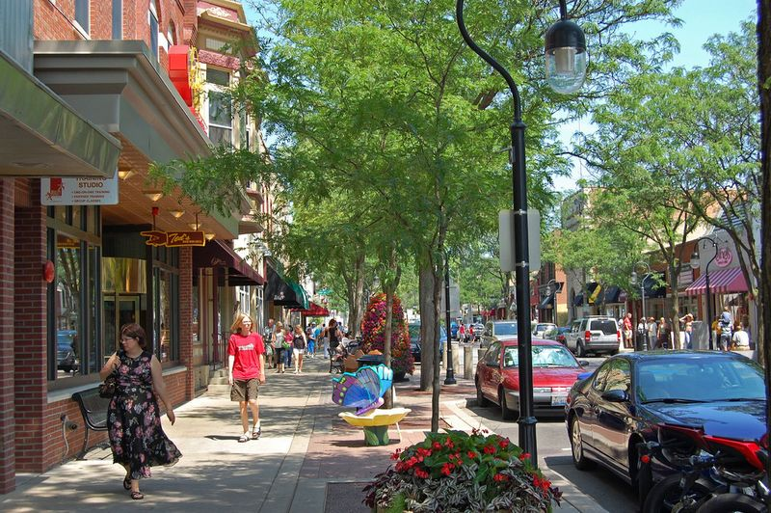
Challenge of Zoning for Walkable, Mixed Use
Canopies/shade
Upper floor design/height
Trees
Street
lights
Signs
Windows/
Storefront
design
Public art
Street
design
Street
furniture
Sidewalk details

Slide 26
Form-Based Zoning
(Focus on Form and Design)
Form
Operations
Use

Slide 27
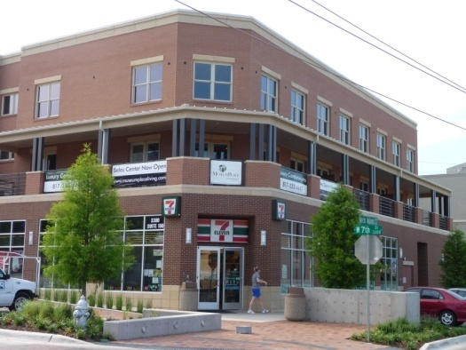
Form-Based Zoning
(focus on form and design)
Mixed use
Minimum and maximum setbacks
Transitions instead of buffers
Form /Design standards
Predictability of outcomes
Attractive to multiple modes
Relate the design of the public realm with the private realm

Slide 29
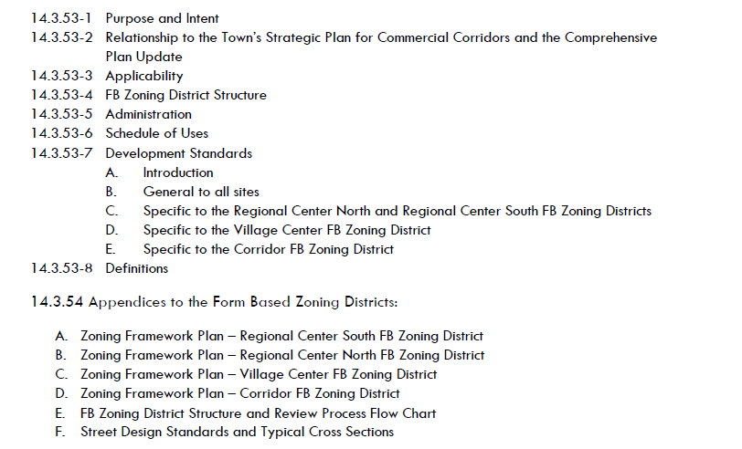
Table of Contents

Slide 30
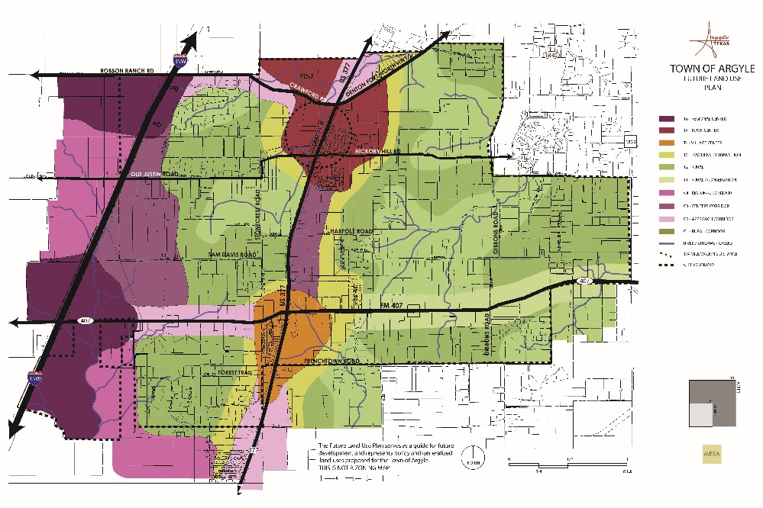
Form-Based Zoning Structure
Form-Based Zoning Districts relate directly to Land Use Districts in the Comprehensive Plan:
  Regional Center: Regional Center and Regional Corridor Land Use District
  Village Center: Village Center Land Use District
  Corridor: Centers Corridor Land Use District

Slide 31
Form-Based Zoning Structure
Each FB Zoning District is further divided into 3 possible component zones
Regional Center North and South:
  Highway Mixed Use
  Regional Center Transition
  Regional Center Neighborhood
Village Center
  Village Center Mixed Use
  Village Center Transition
  Village Center Neighborhood
Corridor
  Corridor Mixed Use
  Destination Mixed Use

Slide 32
Development Review and Approval Process
Tiered Approval Process:
  Zoning Framework Plan adopted at rezoning
  Master Development Plan (approved by Town Council after P&Z recommendation)
  Site Plan
    Type 1
    Type 2

Slide 33
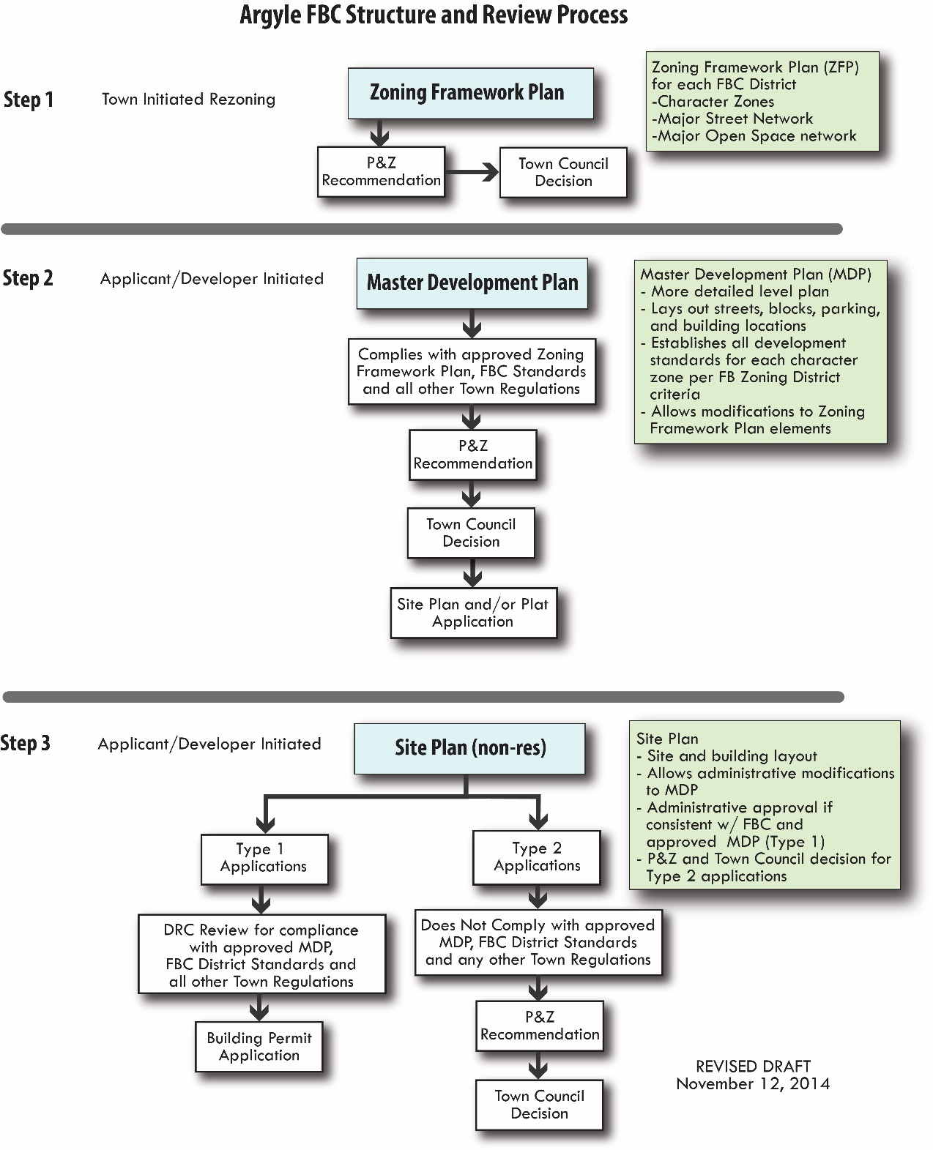
Tiered Review and
Approval Process for Development

Slide 34

Tiered Review and
Approval Process for Development

Slide 35
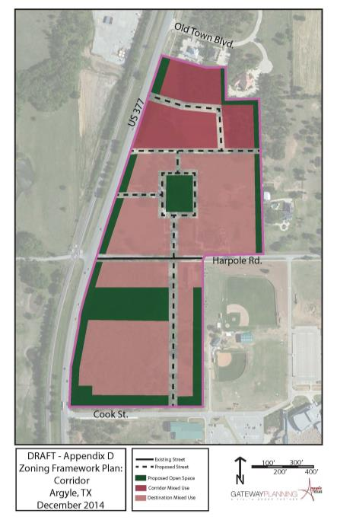
Zoning Framework Plan:
Corridor

Slide 36
Tiered Review and Approval Process for Development

Slide 37

Tiered Review and Approval Process for Development
STAFF APPROVAL
P&Z and Council
APPROVAL

Slide 38
Performance and Design Standards
Applies during the creation of a Master Development Plan (MDP) by applicant
General standards applicable to all Form-Based Zoning District
  General layout
  Street design
  Open Space
  Special Designations
  Building Design
  Architectural Design
  Parking
  Screening and landscaping
Standards specific to each form-based zoning district

Slide 39
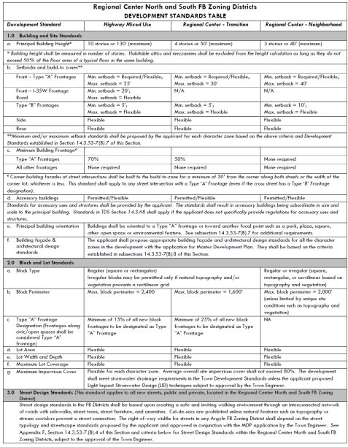
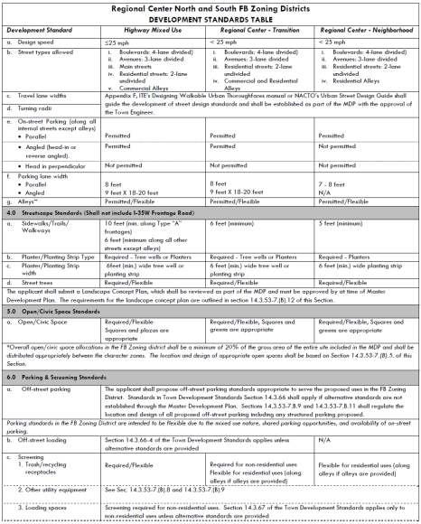
SAMPLE

Slide 40
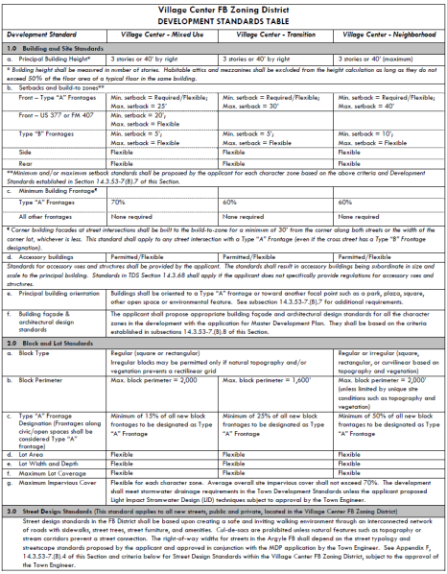
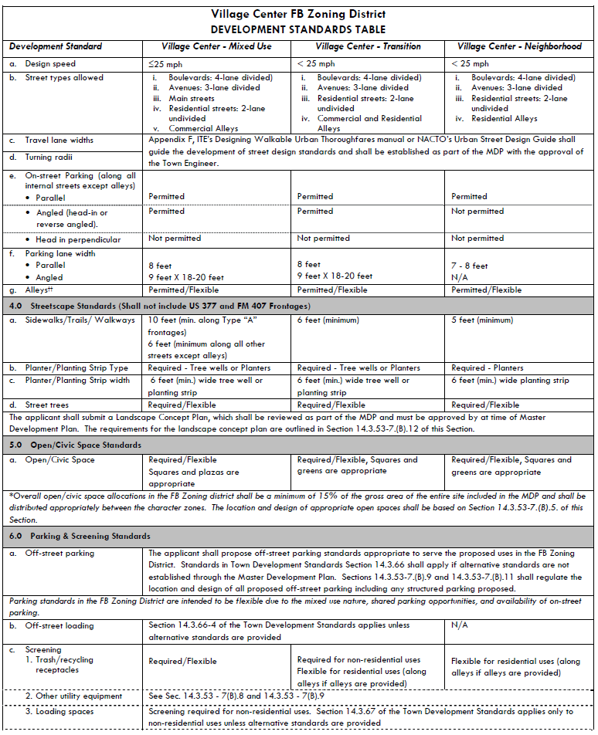
SAMPLE

Slide 41
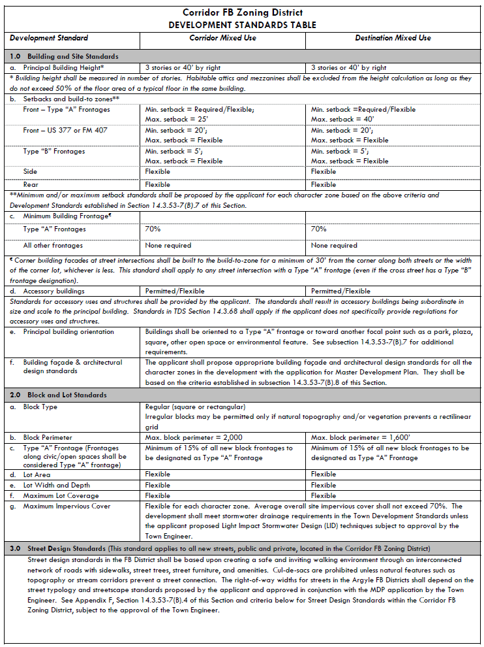
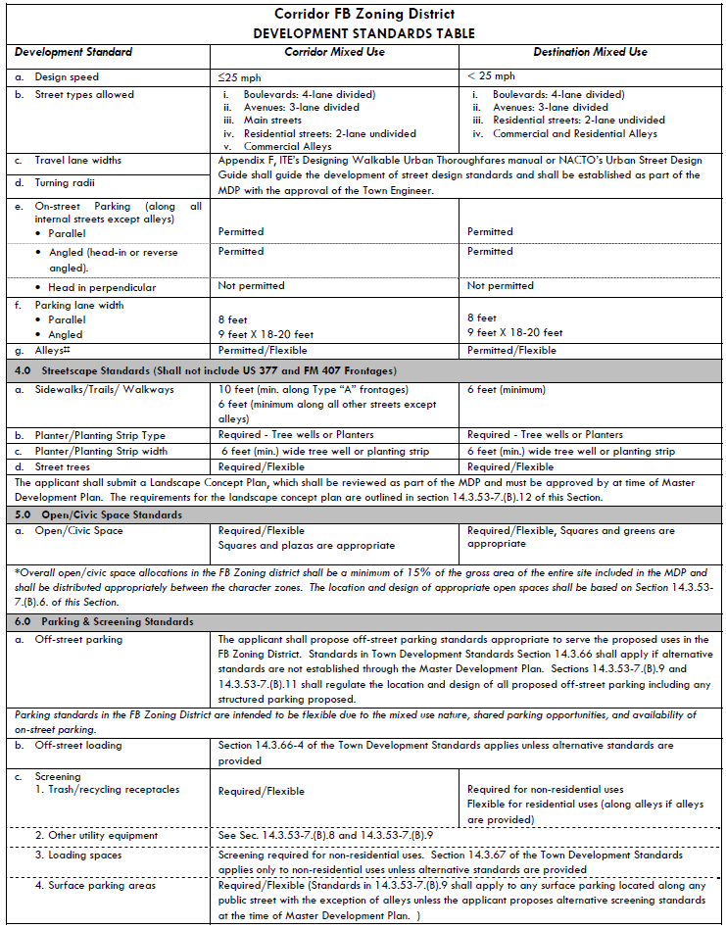
SAMPLE

Slide 42
Goals of Argyle’s FBC
Creating neighborhood AND developer certainty
Incentivizing coordinated private/public sector investment in infrastructure
Balancing prescribed quality with market flexibility
Efficient development review/entitlement process
Designing roadways to support town character via creating special street types for the FBC Areas
To attract the Town’s fair share of quality mixed use (retail, restaurants, and residential) to minimize the tax burden on existing residents

Slide 43
Are the Goals of the FBC still valid and applicable to Argyle?

Slide 44
Critical Issues and Challenges

Slide 45
Common Challenges with
Implementing FBCs
Code is too detailed/complex
Difficult for applicants to understand/apply (making it more expensive to develop and longer for approvals)
Developments require a lot of modifications (or variances) to the code
Resulting development does not look anything like the original vision (images in the code are intended to illustrate the principles of good urban design)
Agreement/expectations on the ultimate outcomes desired

Slide 46
Common Challenges from Various
FBC Implementation Efforts
Infill, redevelopment areas are more complex to apply FBCs:
  Lack of master development plan
  Smaller properties that are owned by multiple property owners making coordination challenging
Be willing to amend code based on what works and does not work within the community context
Need for flexibility in interpreting some of the more subjective requirements of the Code

Slide 47
Other Considerations
Designation of sub-districts and flexibility to move the sub-district boundaries
Conflicts between sections of the code and conventional zoning (of surrounding properties)
Outcomes desired by the community (are the development projects under the FBC better than projects under conventional zoning?)
Doctrinaire adherence to the code creates challenges; but modifications may set a precedent that may be undesirable
Where to establish the flexibility threshold for good projects to come forward – focus on continuity of streets and pedestrian frontages

Slide 48
Next Step Options
Repeal the FBC ordinance in its entirety
  Cons: Could limit the city’s ability to maximize the quality commercial development that it can attract, especially along IH-35W (Comprehensive Plan will have to be amended to be consistent)
Modify the FBC to provide it as an option (similar to the city’s PD District) with the requirement for mixed use and walkability

Slide 49
Discussion

