Slide 1

City of Argyle Stonecrest Road Roadway improvements
DDM Construction Corporation

Slide 2
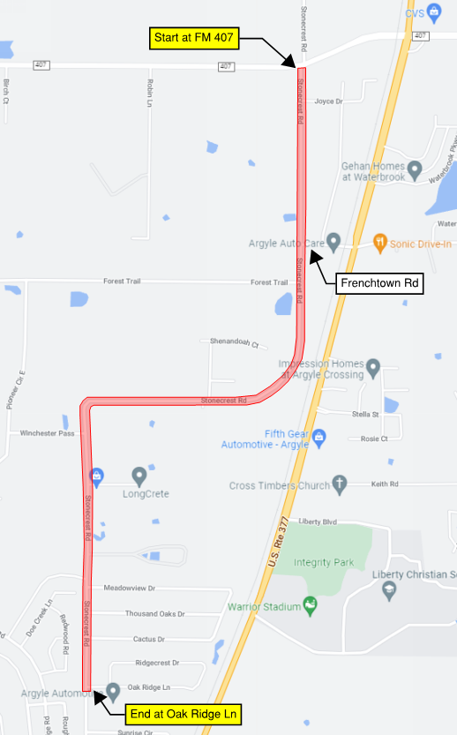


General Info
Contractor: DDM Construction Corp
Project Limits: Stonecrest Road from FM 407 (North end) to Oak Ridge Ln (South end)
Project Website: txstonecrest.com
Closures & Detours
General News & Updates
Project Email: stonecrest@ddmcc.net

Slide 3
Project Scope
210 Calendar Days – not including weather days or material shortage
(First) Full Southbound Lane reconstruction
(Second) Full Northbound Lane reconstruction
Traffic one-way Southbound for duration of project
Speed limits strictly enforced
Access to driveways and side streets kept at all times with a few exceptions
Residents will be notified of closures in advance
Project Process
Barricades & Detour Routes set
Mill out existing pavement
Treat subgrade with lime slurry
Place new concrete pavement
Minor ditch grading, no drainage reconstruction

Slide 4
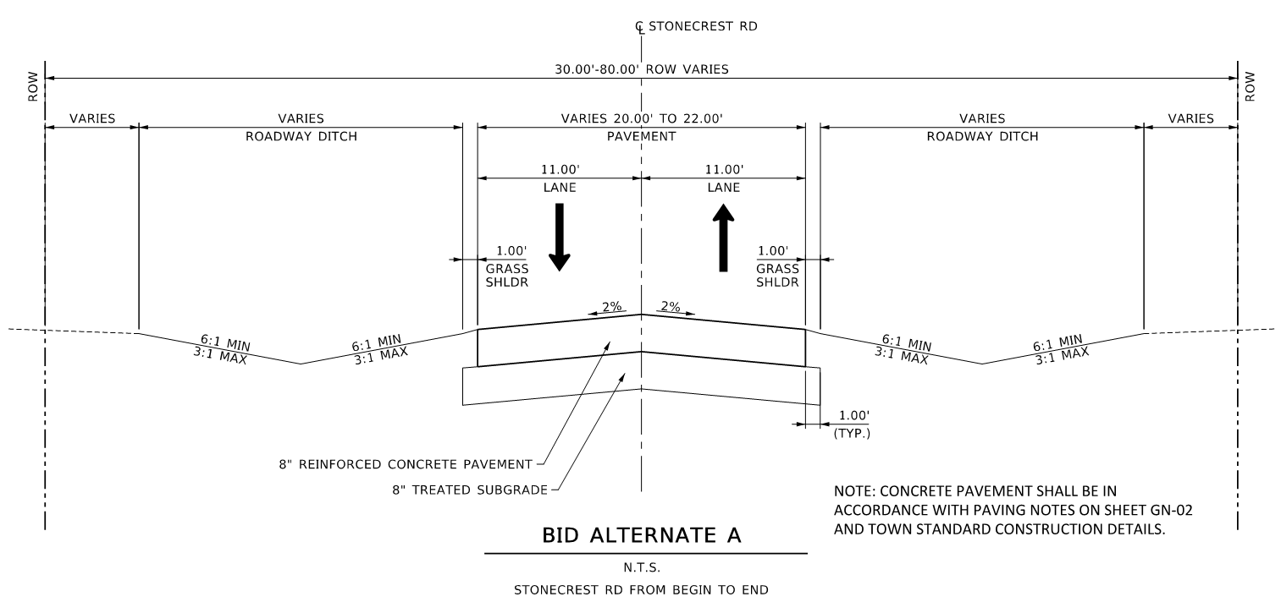
Project scope
Width varies from 20’ to 22’ (10’ to 11’ lanes)
Remove Existing Asphalt & Base Material
8” thick treated subgrade
8” thick concrete paving
Permanent striping will take place after pavement complete
1’ shoulder repair with Bermuda hydromulch

Slide 5
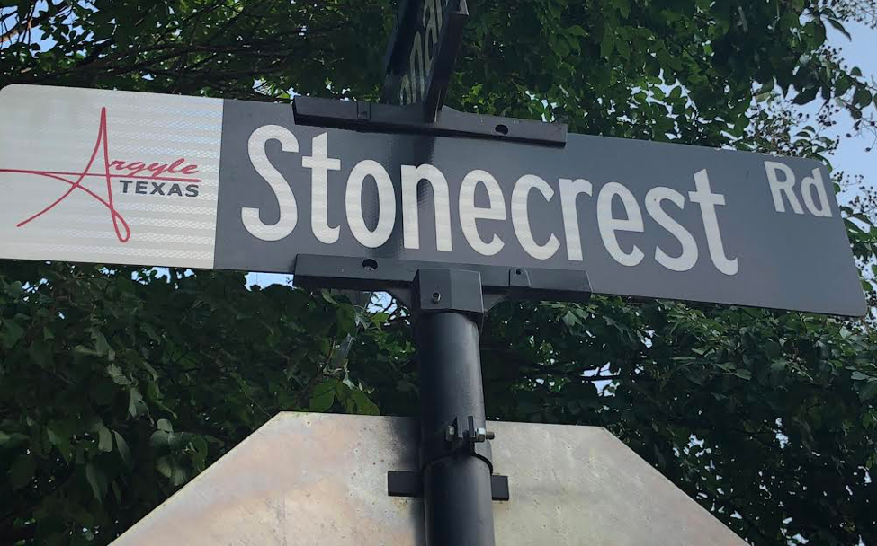
subcontractors
Massey: Erosion Control
Buyers Barricades: Traffic Control
Rockin C Milling: Milling
Reliable Concrete Cutting: Saw & Seal
Advanced Paving: Asphalt Paving
Stripe-A-Zone: Pavement Markings
Crossroads: Signs
Greenscaping: Seeding

Slide 6


Questions

