Slide 1
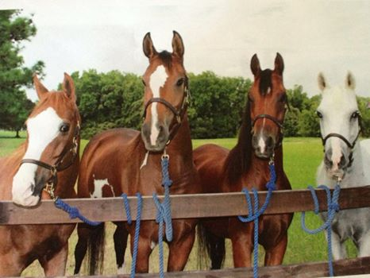

Stonecrest Reconstruction Community Meeting April 21, 2022

Slide 2
Stonecrest Reconstruction Community Meeting
Introductions
1. Town of Argyle officials
2. Denton County officials
3. Freese and Nichols representatives
4. DDM personnel
Project history and funding sources
1. 2022 Street program
2. Interlocal agreement with Denton County
3. Design criteria
4. Project Bid
April 21, 2022

Slide 3
Stonecrest Reconstruction Community Meeting
Funding for the 2022 Street Program comes from the $3.25 million CO issued in December of 2021. This funding was earmarked for the improvement of four roads: Stonecrest, C. Taylor, Hickory Hill and Frenchtown. A revised cost estimate places doing all the roads over $5 million.
The Town of Argyle and Denton County have entered into an interlocal agreement for the reconstruction of Stonecrest from FM 407 to the Flower Mound Town limits.
The town engineer has determined that the overall length of the project is 9,175 linear feet.
The County share is 2,510 linear feet or 27.4% of the overall project length with a cap of $496,421
The Town of Argyle share of the project would be 6,665 linear feet or 72.6% of the overall project cost.
April 21, 2022

Slide 4
Stonecrest Reconstruction Community Meeting
Town and County staff opened bids on the project on March 1, 2021.
The town received nine bids
Lowest bidder for asphalt was Jagoe Public Company, at $1,798,946
Lowest bidder for concrete was DDM at $2,303,726
The base project was for an asphalt road with 8 inches of cement tread subgrade and 8 inches of asphalt. Concrete road with 8 inches of cement tread subgrade and 8 inches of concrete.
April 21, 2022

Slide 5
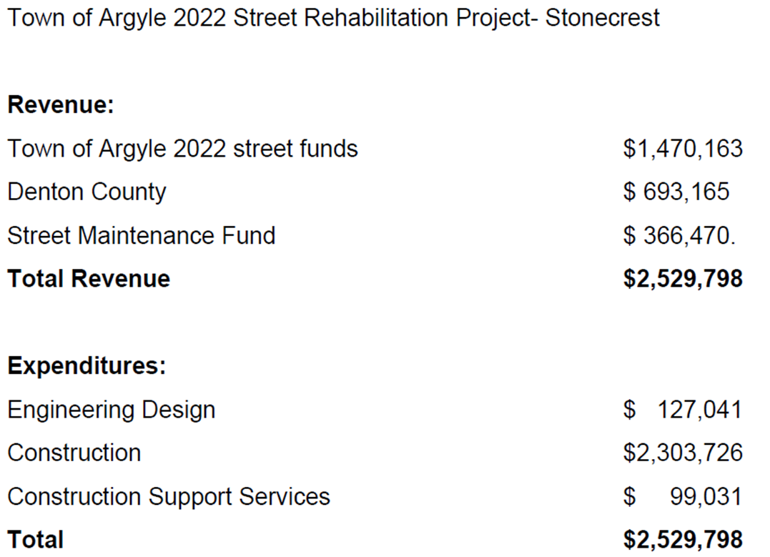
Stonecrest Reconstruction Community Meeting
April 21, 2022

